Slide 1
Rural Health Commissioning Team
Te Manawa Taki

Slide 2
Regional System Integration Team
Angela Olsen
Lisa Gestro
Executive Assistant to GM, Regional System Integration
Group Manager, Regional System Integration,
Te Manawa Taki Region
Khaliah Tapu
Chloe Mercer
Kirk Mariner
Jo-Anne Deane
Tim Slow
Regional Manager, Rural Health
Regional Manager, Living Well
Regional Manager, Mentally Well
Regional Manager, Ageing Well
Regional Manager, Starting Well
Connie Magee
Team Administrator
Brent Gilbert De Rios
System Design Manager,
Rural Health
Person
Principal Services Development Manager, Rural Health
Person
Senior Services Development Manager, Rural Health
Person
Clinical Advisor, Rural Health
(0.5 FTE)

Slide 3
Rural intersecting the wider commissioning teams
Taranaki
Waikato
BOP
Lakes
Tairawhiti
Rural Health
Starting Well
Living Well
Aging Well
Mentally Well

Slide 4
Rural Health & Living well
Rural Health
Rural Health
Rural Hospitals
Travel & Accommodation Services
Planned & Unplanned Care
Planned Care
Palliative Care
Radiology
Women’s Health
Cancer
xxx
Hospitals in the home
POAC / EPC
Acute Flow
Urgent & After Hours
Primary Care
Primary Care
Pharmacist Services
Reproductive Health
Refugee & Migrant Health
Community NGO’s
Long Term Conditions
Comprehensive Primary Care Teams & WF
Ambulance
Air Ambulance
Road Ambulance
Autonomy
Assisted Dying
Abortion Services
Laboratory
Telehealth
Primary Care ICT
Planned & Unplanned Care

Slide 5
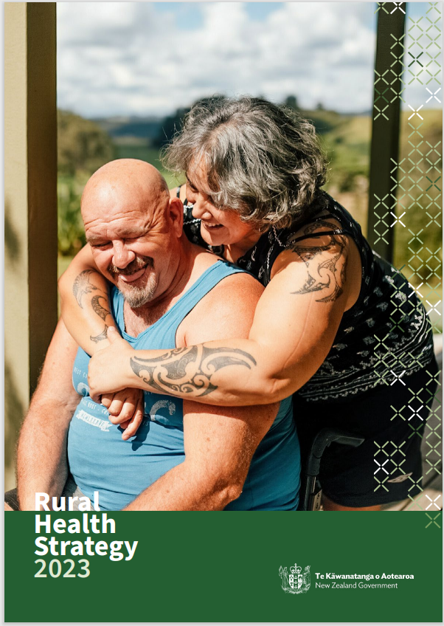
National Rural Health Strategy (2023)
Considering rural communities as a Priority Group
Prevention: paving the way to a healthier future
Services are available closer to home for rural communities
Rural communities are supported to access services at a distance
A valued and flexible rural health workforce
https://www.health.govt.nz/publication/rural-health-strategy
Notes:
Te Pae Tata and this will provide framework essential to Regional RH workplan and align back to reporting functions

Slide 6
Our Functions the Regional System Integration Team
Procuring and service agreements across all primary and community care services and managing provider relationships
Ensuring funded services are of high quality, within compliance requirements and within budget.
System and service re-design and implementation across the life span in the Region
Developing (inputting into) and implementing the Strategic Regional Road map (Regional Services Plan) for the Life Course across the region.
Implementing regional integration change programmes.
Developing new service and funding models for aged care and community health services across the Life Course in the region.
Sector facing engagements across the NGO funded sector in the Region.
Management of key operational issues that occur across a network of providers across a region and/or a locality.
Effectively managing full regional commissioning budget, including development of that budget in partnership with regional finance partners and tracking against the budget.
Create and maintain strong collaborative relationships across Te Whatu Ora Business units, regional and national commissioning teams, and Te Aka Whai Ora.

Slide 7
Person-centred way of understanding rural investment …..
We’ve inherited a complicated, fragmented funding and contracting system.
Rural hospitals are one mechanism for delivering services to rural communities. PHO, NGO, and Te Whatu Ora also contribute to the mix.
How funding ‘lands’ in rural communities does not appear to be equitable.
Funding and contracts haven’t been explicitly designed to support sustainable rural models of care.
You are significant, critical providers in your community, and also not the only providers.

Slide 8
On the horizon
National Rural Clinical Heatlh Telehealth Services
Rural Recruitment Service & Locum Support
Review of PRIME
Rural Hospital Stabilisation
National Transport Assistance
Bus subsidy

